Slide 1
How Does a Bike-Share Navigate Speedy Success
Cylistic Bike-Share
March, 2024

Slide 2
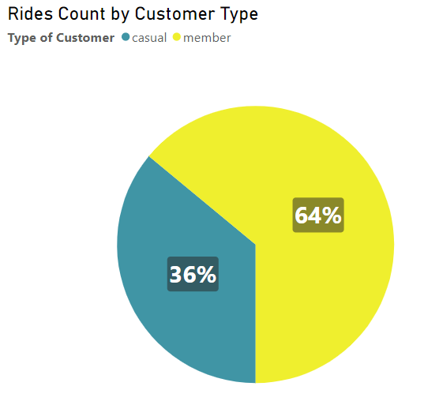
First Question
How annual members and casual riders differs?
5,719,877 total rides in 2023.
3,660,698 member rides.
2,059,179 casual rides.

Slide 3
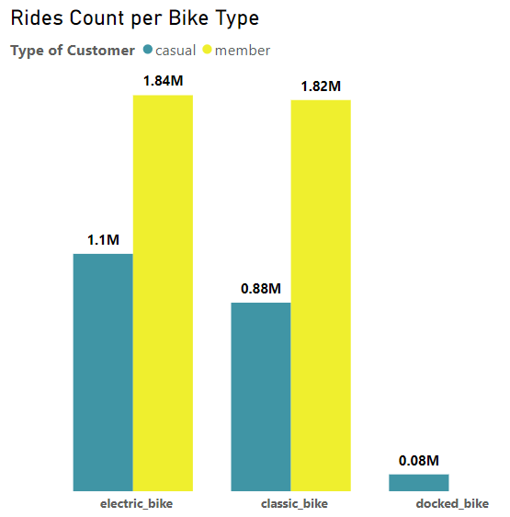
First Question
How annual members and casual riders differs?
Data confirmed that members have the most rides during 2023.
Casual riders are the only ones who uses the docked bikes.
Casual Riders preferred electric bike, might because they need a speeder option.

Slide 4
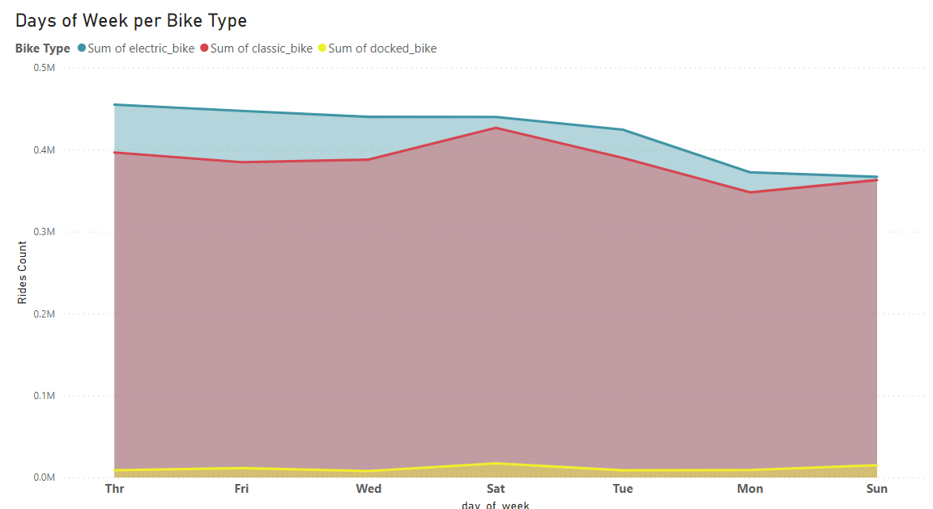
First Question
How annual members and casual riders differs?
Thursday is the most day customers prefer electric bikes.
Customers in general tends to use electric bikes.

Slide 5
Second Question
Why casual riders buy the annual membership?
Casual Customer spend more time in average than Members.
Customer Type | AVG Rides Duration
Casual | 28
Member | 12

Slide 6
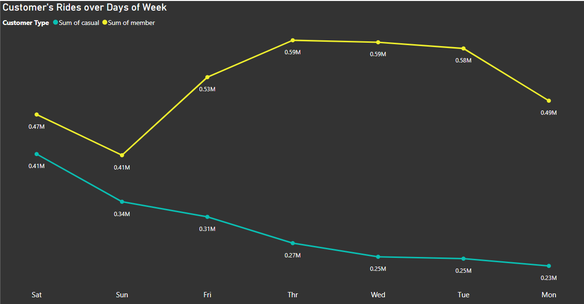
Second Question
Why casual riders buy the annual membership?
Casual customers tend to use bikes in Saturdays in every week, in anther meaning: in weekends.

Slide 7
Conclusion:
We can create a simple campaign to attract student casual customer for docked bike that will tell them about advantages of this bike to keep them belongs safe in the its basket during their journey.
We can make promotions in Thursdays for electric bikes specially to increase the frequency of using.
While casual customers have the biggest average of time spending in using our bikes, so we can use this information to attract this kind of customer to save their money through our memberships discount.
Every weekend we can for example give our customers one free hour for electric and classic bikes.

Slide 8
Future Plans:
We should develop over 500 stations to make it more easer to use for classic bikes users.
Creating an app that contains:
All our offers for customers in tap.
Anther tap with new services to bike (food, drinks, rests and ideas for picnics with bikes.
A new option to customers to use their own bikes through our stations with a fair price.

Slide 9
Thank You

